Slide 1

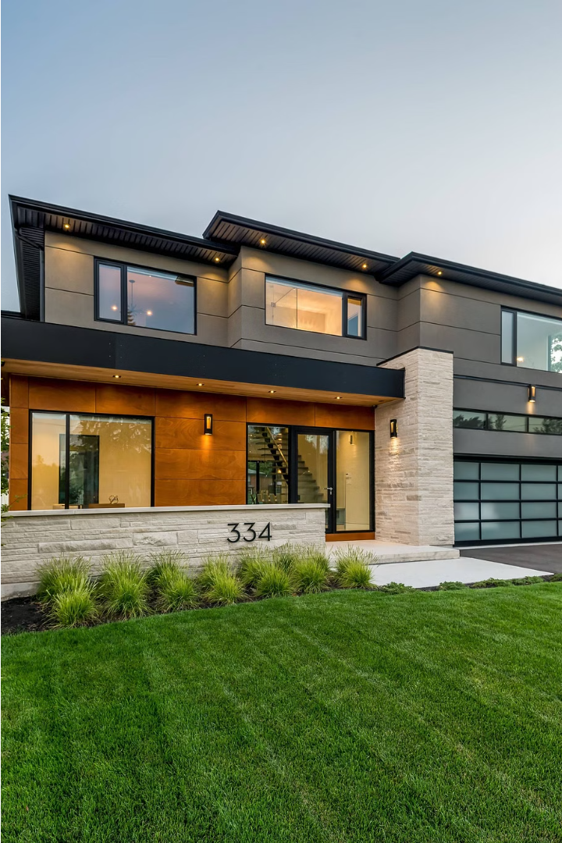

Introduction to House Price Prediction with Generative AI
Explore how cutting-edge AI technology is revolutionizing the real estate industry. Learn how generative models can accurately forecast home values, empowering both buyers and sellers to make informed decisions.
By Aarthi

Slide 2
Overview of the Housing Market and Challenges
Volatile Pricing
Limited Supply
The housing market is known for its unpredictable price fluctuations, making it difficult for homebuyers to make informed decisions.
In many regions, the supply of available homes fails to meet the growing demand, leading to fierce competition and higher prices.
Affordability Barriers
Diverse Market Dynamics
Rising interest rates and soaring home prices have created significant affordability challenges, pricing many aspiring homeowners out of the market.
The housing market is influenced by a complex interplay of economic, demographic, and local factors, making it challenging to predict trends.

Slide 3

Fundamentals of Generative AI Models
Generative AI models are a class of machine learning algorithms that can create new, synthetic data that resembles the original training data. This includes generating images, text, audio, and other types of content.
These models, such as Generative Adversarial Networks (GANs) and Variational Autoencoders (VAEs), learn the underlying patterns and distributions in the training data, allowing them to generate realistic and diverse new samples.
Key concepts in generative AI include latent space, adversarial training, and conditional generation, which enable these models to produce highly customized and controllable output.

Slide 4
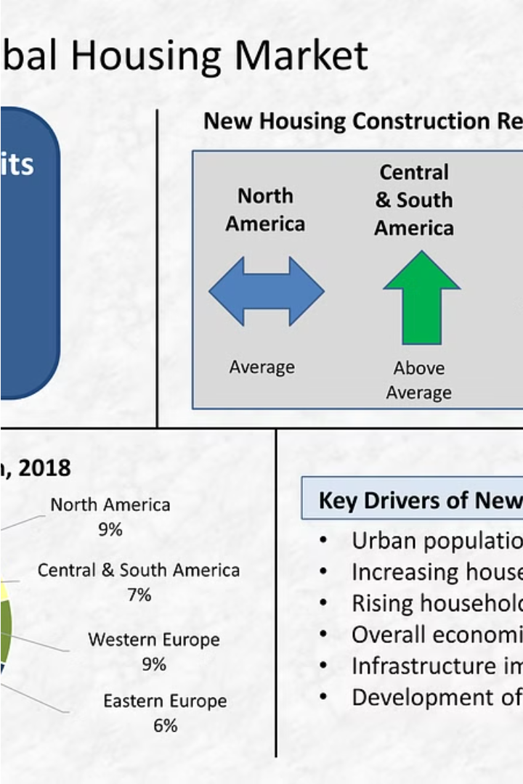
Data Collection and Preprocessing
Collecting comprehensive housing market data is crucial for accurate price predictions. This involves aggregating information from various sources, including real estate listings, census data, and economic indicators.
Preprocessing the raw data is essential to ensure it is clean, consistent, and ready for analysis. This includes handling missing values, removing outliers, and converting data into standardized formats.

Slide 5
Feature Engineering for Housing Data
Identifying Key Factors
Transforming Variables
Scaling and Normalization
Encoding Spatial Data
Analyze the available data to determine the most influential factors that impact home prices, such as location, square footage, number of bedrooms/bathrooms, and amenities.
Convert categorical variables into numerical representations, handle missing values, and engineer new features that capture complex relationships in the data.
Ensure the feature values are on a comparable scale to optimize the performance of the generative AI model during training and prediction.
Leverage geographic information, such as GPS coordinates or neighborhood characteristics, to capture the spatial context that influences housing prices.

Slide 6
Architectural Design of the Generative AI Model
Model Architecture
1
The generative AI model for house price prediction will utilize a deep neural network architecture, leveraging the power of unsupervised learning techniques to capture complex patterns in housing data.
2
Feature Extraction
Crucial features such as location, square footage, number of bedrooms/bathrooms, year built, and neighborhood characteristics will be extracted and fed into the model to enhance its predictive capabilities.
Generative Adversarial Networks
3
The model will incorporate Generative Adversarial Networks (GANs), where a generator network learns to produce realistic house price estimates while a discriminator network evaluates the validity of the generated outputs.

Slide 7
Training and Validation of the Model
1
Data Splitting
2
Iterative Training
The housing dataset is split into training, validation, and test sets to evaluate the model's performance during development and ensure generalization to new data.
The generative AI model is trained in an iterative process, with the validation set used to monitor for overfitting and guide hyperparameter tuning.
3
Performance Metrics
4
Convergence and Stability
Key metrics like mean squared error, R-squared, and prediction intervals are used to assess the model's accuracy and reliability in forecasting house prices.
The training process continues until the model converges and demonstrates stable performance on both the validation and test sets.

Slide 8

Generating Accurate House Price Predictions
With the generative AI model in place, the next critical step is to generate accurate house price predictions. This involves fine-tuning the model's parameters, leveraging historical data, and incorporating market insights to produce reliable forecasts.
By analyzing a wide range of factors, such as location, square footage, number of bedrooms and bathrooms, the model can generate highly accurate estimates of a home's potential value. This empowers buyers, sellers, and real estate professionals to make informed decisions.

Slide 9



Interpreting and Analyzing the Model Outputs
Predictive Accuracy
1
Evaluating the model's ability to forecast home prices
Feature Importance
2
Identifying the key factors driving price predictions
Market Insights
3
Extracting trends and patterns from the model outputs
Analyzing the outputs of the generative AI model is crucial to unlocking its full potential. By assessing the predictive accuracy, understanding the relative importance of different features, and extracting valuable market insights, you can refine the model, make informed decisions, and ultimately deliver more reliable and impactful house price forecasts.

Slide 10




Practical Applications and Future Developments
Real Estate Valuation
Investment Strategies
Urban Planning
Continued Research
Generative AI can support city planners in predicting the impact of new developments, enabling better-informed decisions about infrastructure, zoning, and community growth.
Generative AI models can enhance real estate appraisal by automating property value estimations, enabling more accurate and consistent pricing.
These models can analyze market trends and forecast home prices, empowering investors to make more informed decisions about buying, selling, and portfolio diversification.
As the field of generative AI continues to evolve, further research and development will likely lead to even more sophisticated and accurate housing price prediction models.

